Slide 1


Integrated Aquaculture-Agriculture Soil Enrichment System (IAASES)
K200286 – Syed Aun Ali
K200421 – Muhammad Fahad Zahid
K200273 – Muhammad Mudabbir
Department of Computer Science, FAST-NUCES, Karachi, Pakistan

Slide 2
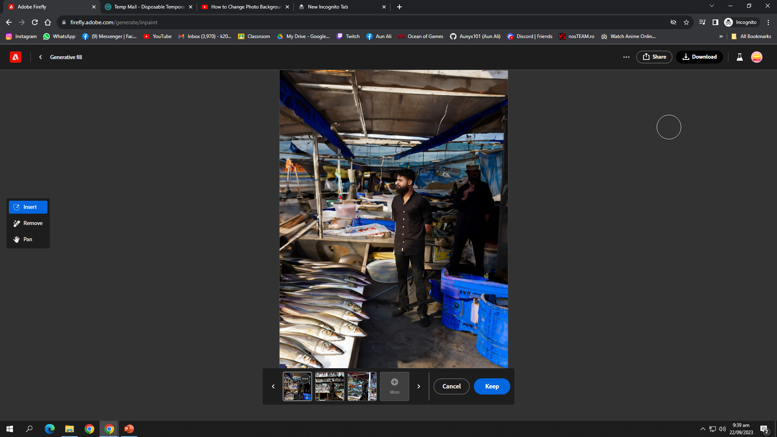
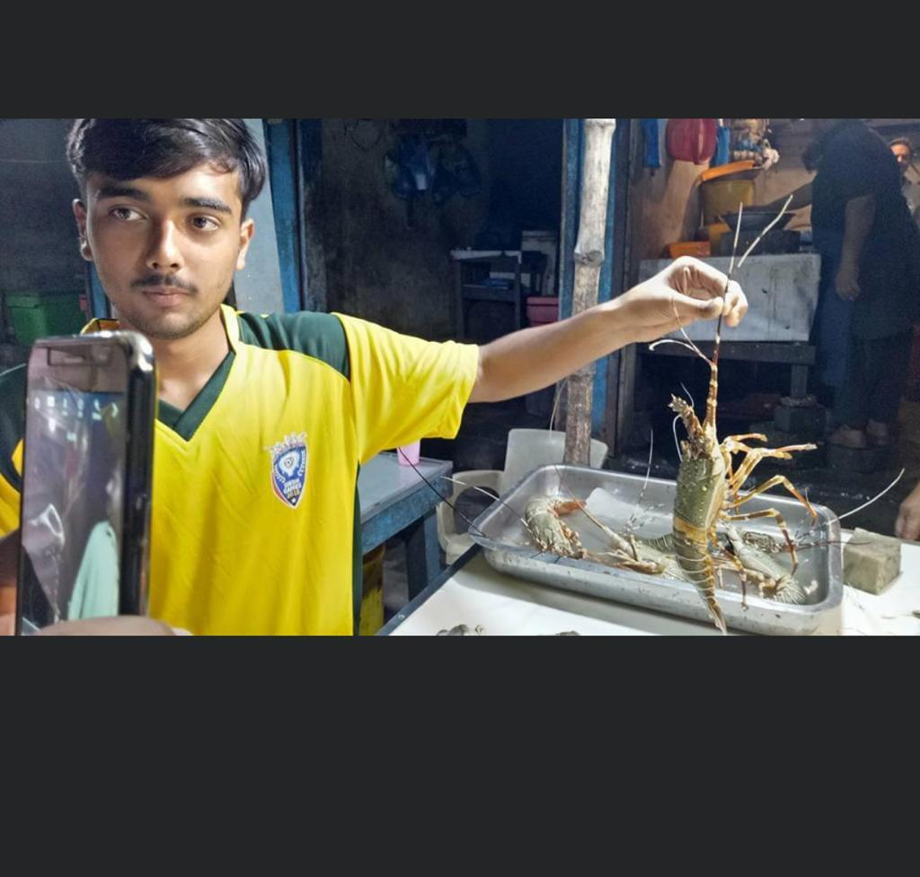
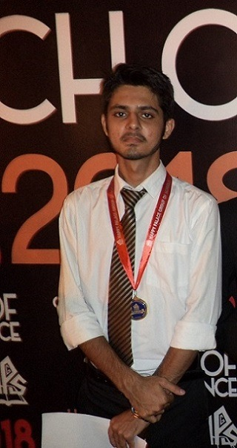
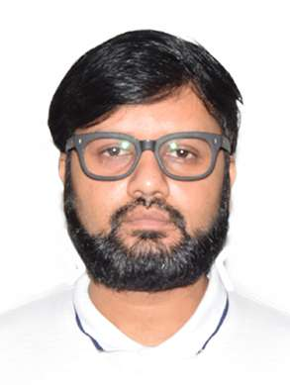
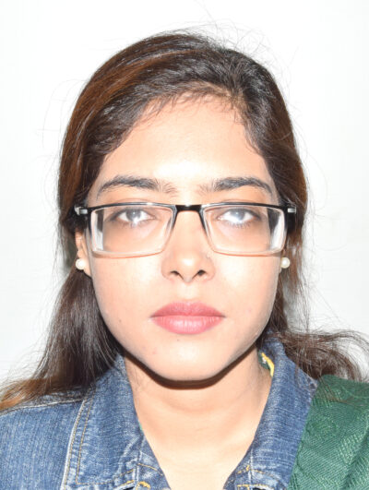
Team
Syed Aun Ali (K200286)
M. Mudabbir (K200273)
M. Fahad (K200441)
▲Collecting Dataset
Dr. Muhammad Farrukh Shahid , PhD
Ms. Sania Urooj
Assistant Professor
Co - Supervisor
Lecturer
Supervisor

Slide 3
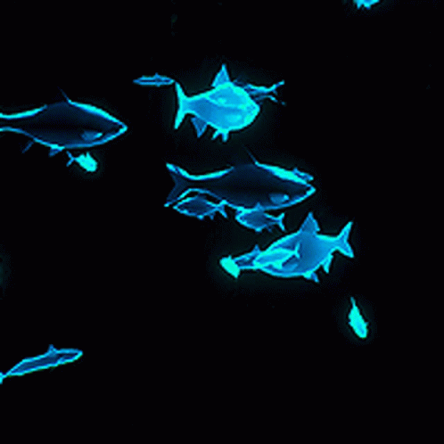
Roadmap
Introduction
Scenario Comparison
Jury Feedback Form & Deliverables From FYP – I Finals
Fish Details At Classification ( Deliverable )
LLM For Nutrient Extraction Procedure ( Deliverable )
Work Planned For FYP II - Finals
Conclusion

Slide 4
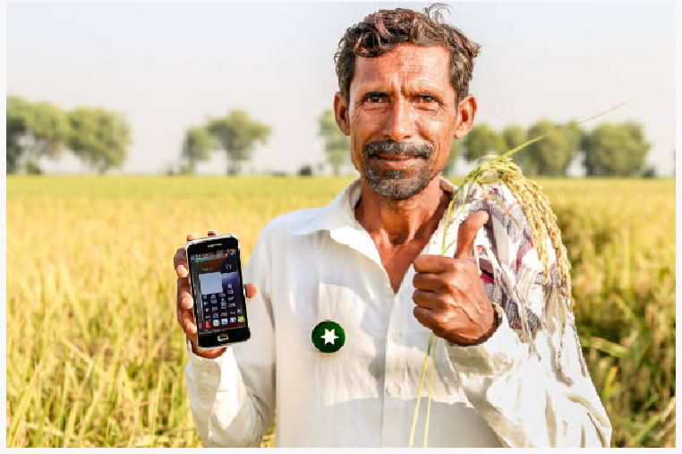
Introduction
Integrated Aquaculture-Agriculture Soil Enrichment System (IAASES): Bridging Sustainability Through Nutrient-Rich Solutions
Focuses on bridging the gap between aquaculture and agriculture using modern technology.
The primary objective is to develop an automated system for soil enrichment by integrating fish hydrolysate (and many other soil enrichment via fishery techniques) with compatible fish species.
This project addresses the growing need for sustainable soil enrichment methods, particularly in the context of agriculture in Pakistan.
Analyzing data using AI and CV models

Slide 5
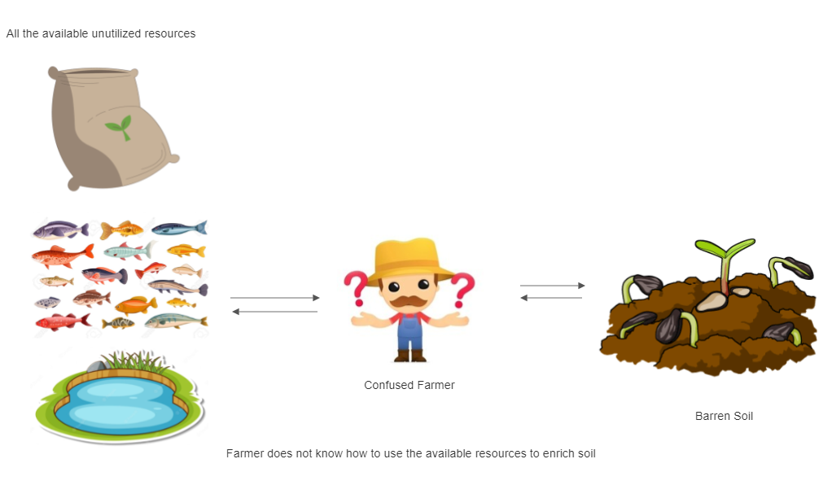
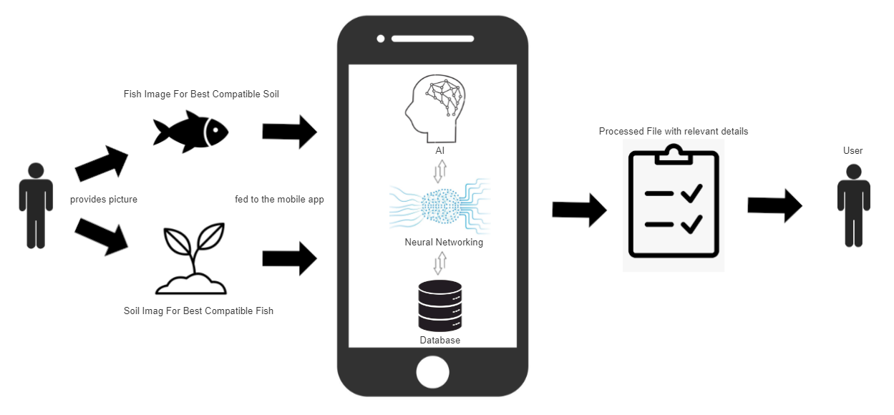
All the available unutilized resources
Current Scenario:
Confused Farmer
Barren Soil
Farmer does not know how to use the available resources to enrich soil
Fish image for best compatible soil
Proposed Scenario:
Processed file with relevant details
Provides picture
User
User
Analyzing data using AI and CV models
Soil image for best compatible fish

Slide 6
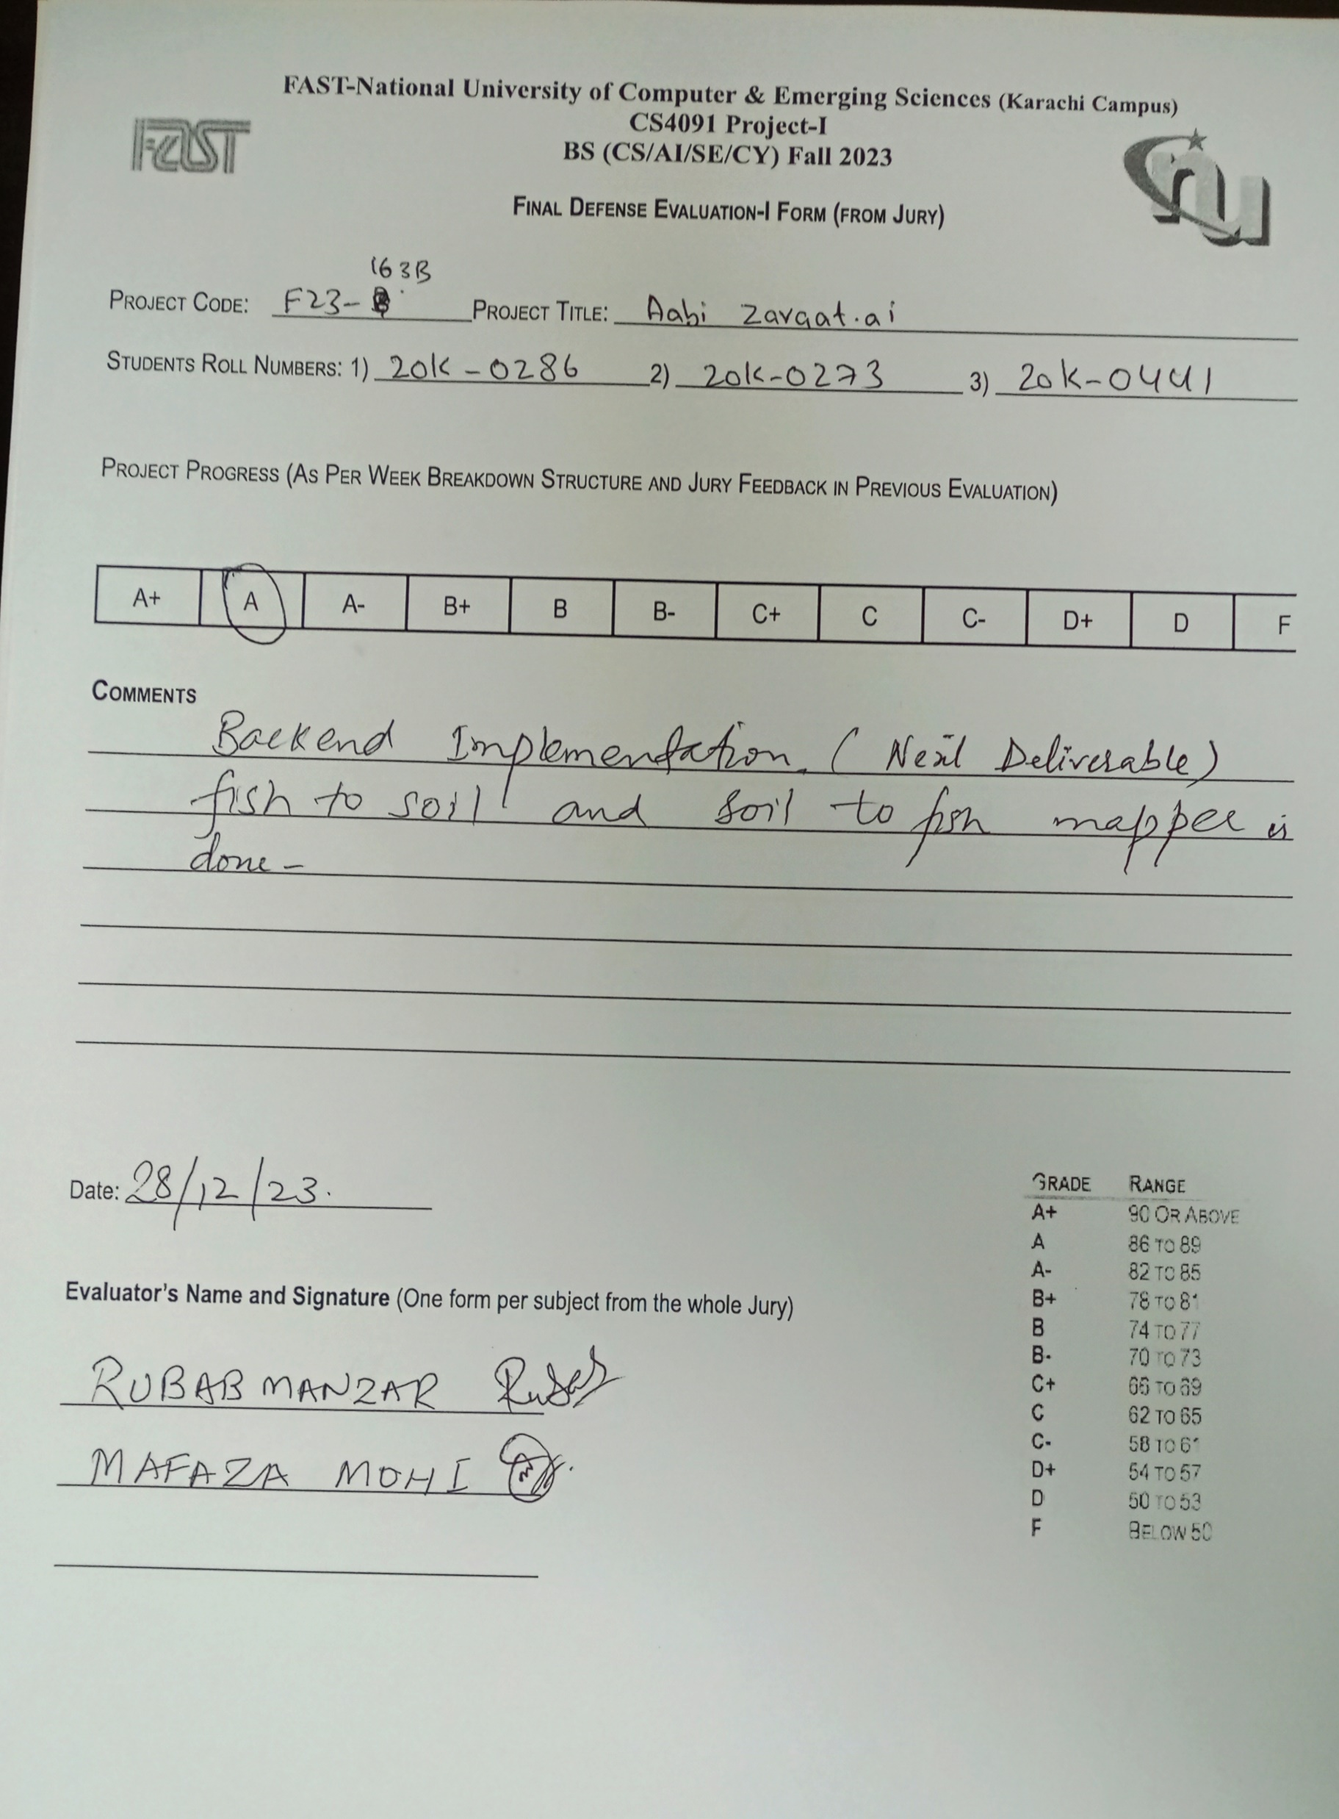
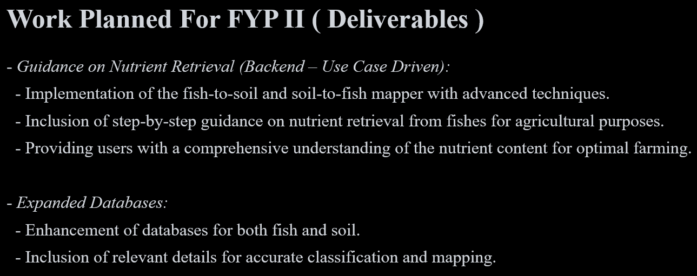
Jury Feedback Form & Deliverables From FYP – I Finals
Analyzing data using AI and CV models
△ Taken From FYP – I Final’s Presentation

Slide 7
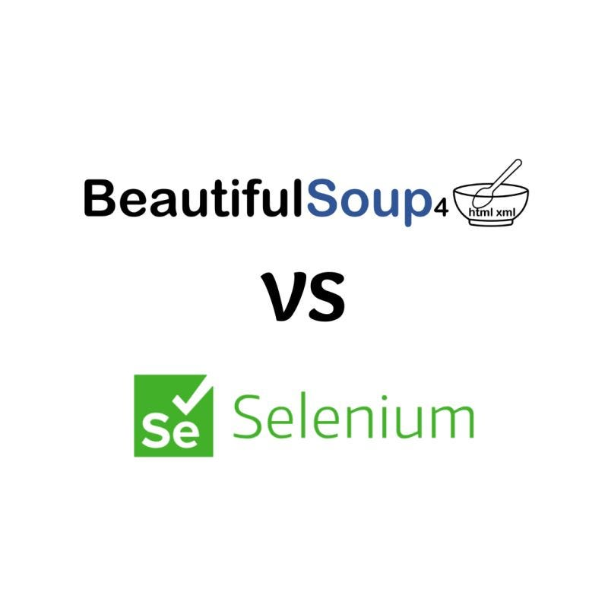
Fish Details At Classification ( Deliverable )
- Process:
- Use Selenium to navigate the website and identify relevant HTML elements.
- Employ BeautifulSoup to extract desired data from HTML content.
- Clean and process extracted data for further analysis.
- Adapt scraping code for website structure variations.
- Ensure robustness with error handling and retries.
- Benefits:
- Automate data extraction for efficiency.
- Enrich datasets with additional web-sourced information.
- Gain valuable insights into fish species and habitats.
&

Slide 8
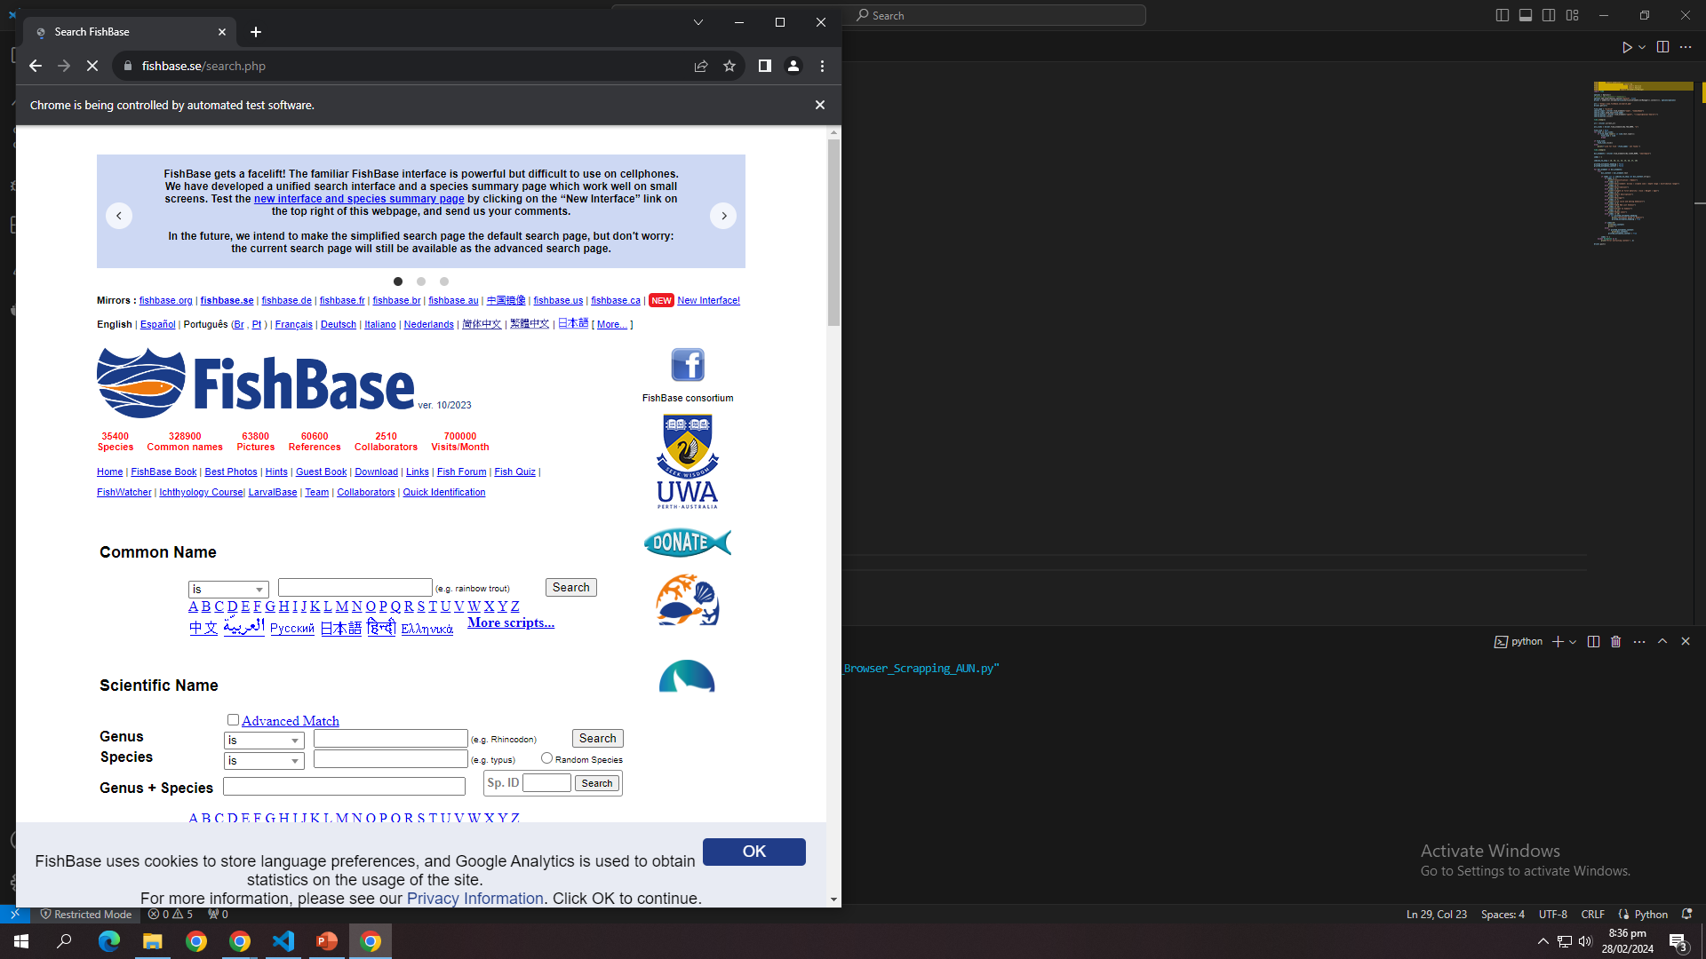

Slide 9
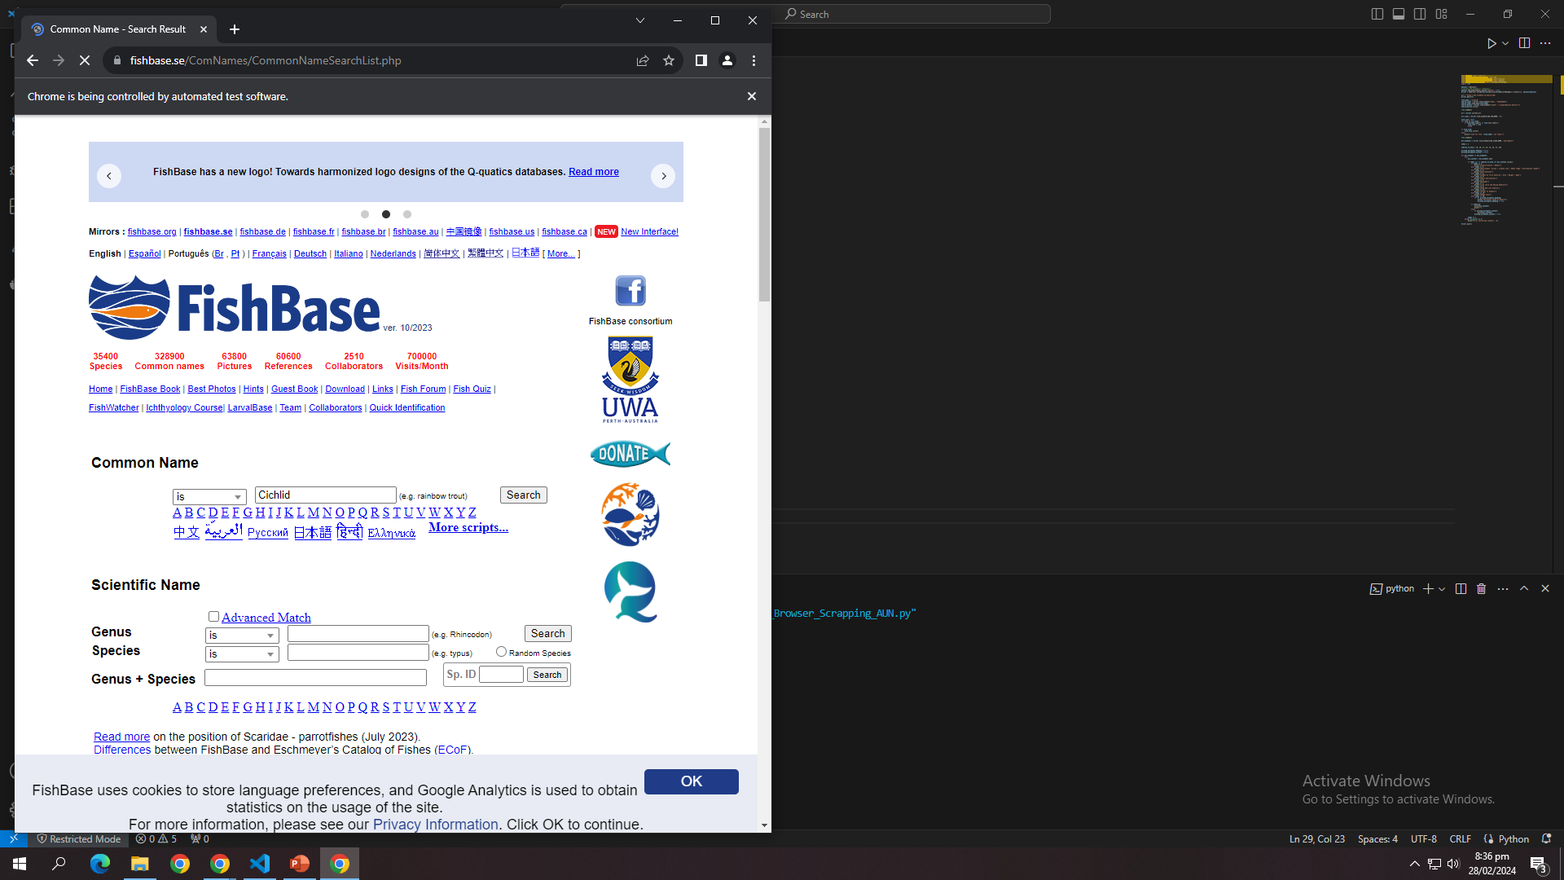

Slide 10
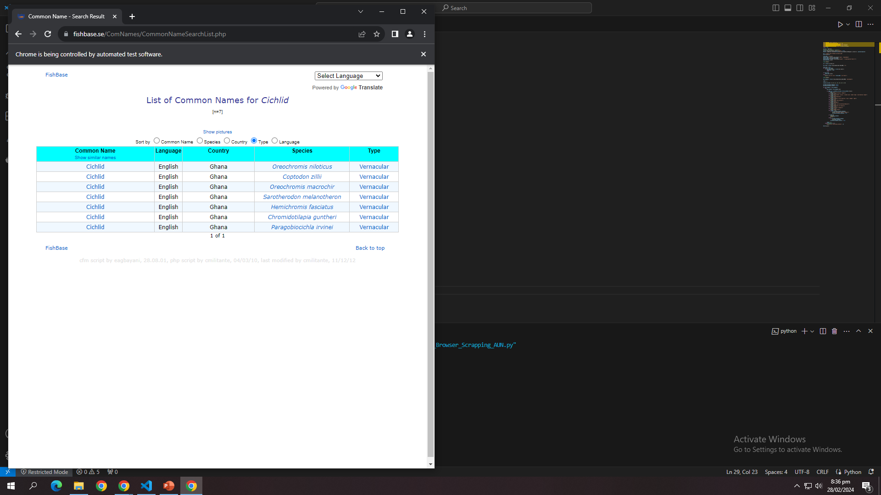

Slide 11
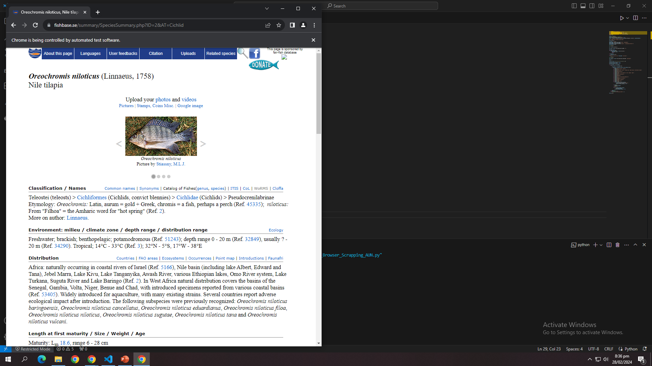

Slide 12
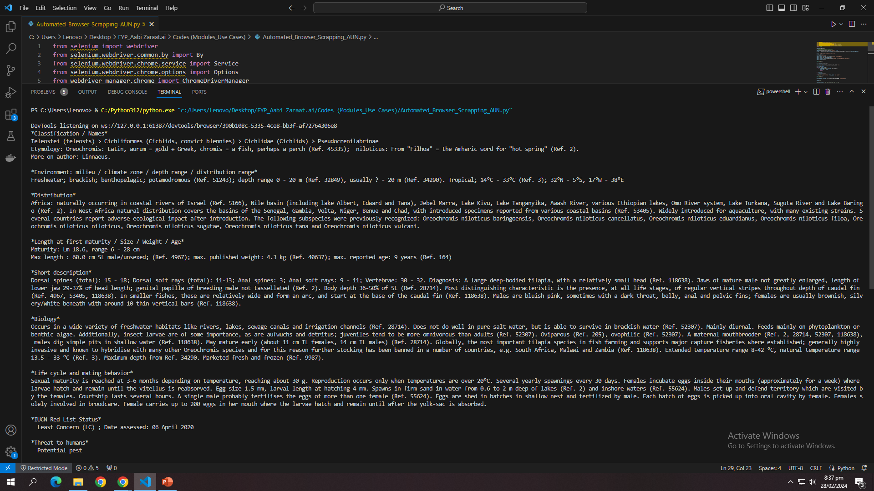
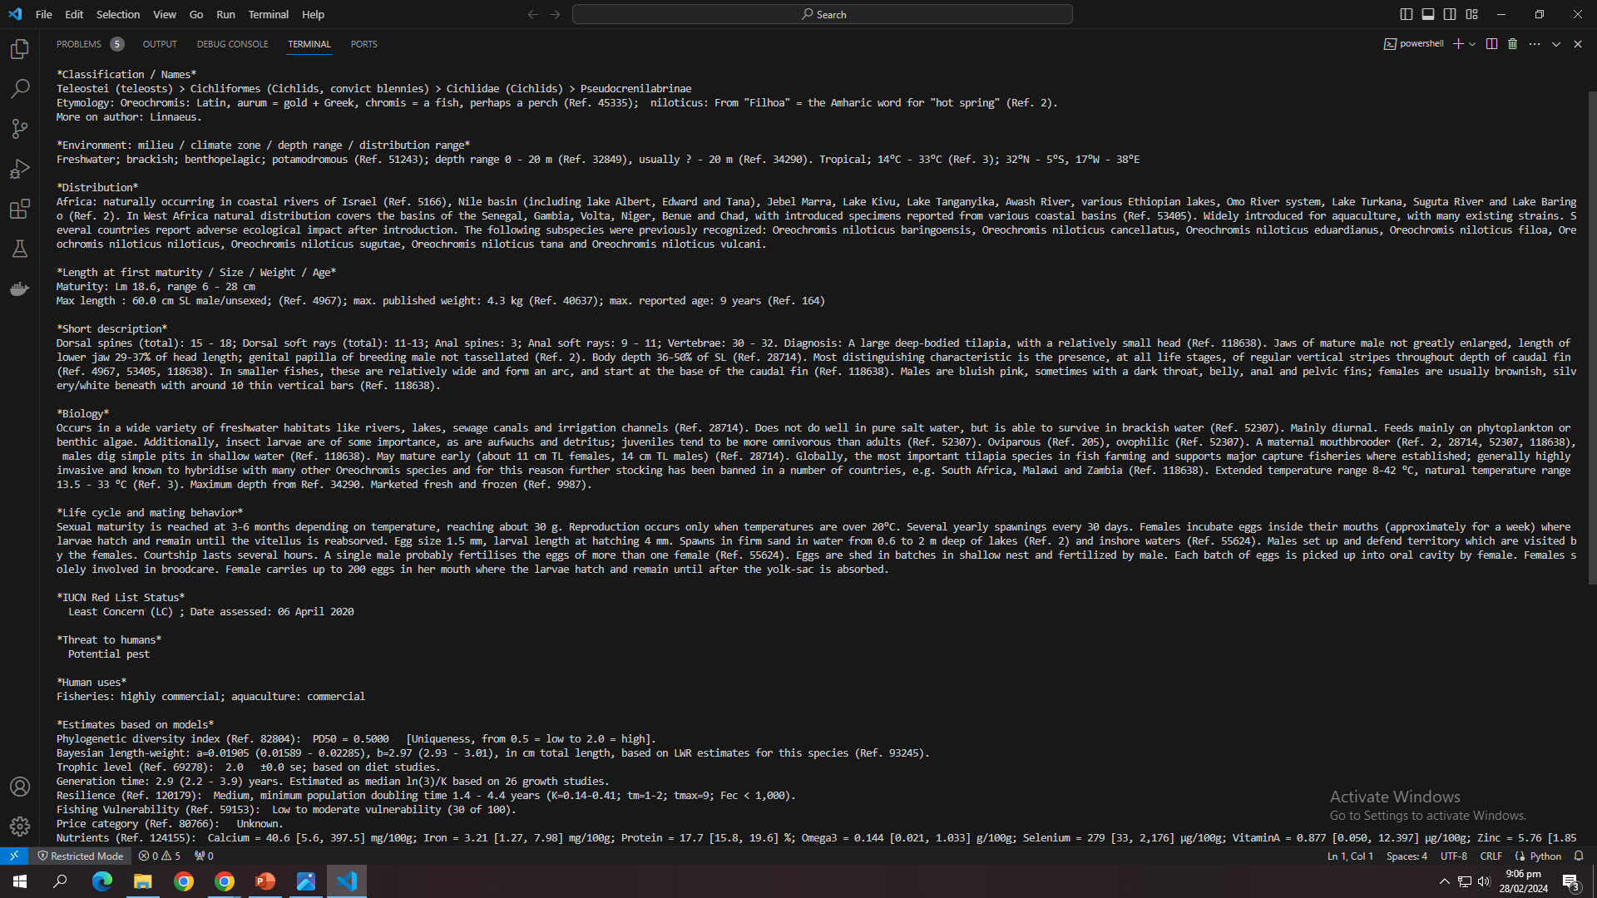

Slide 13
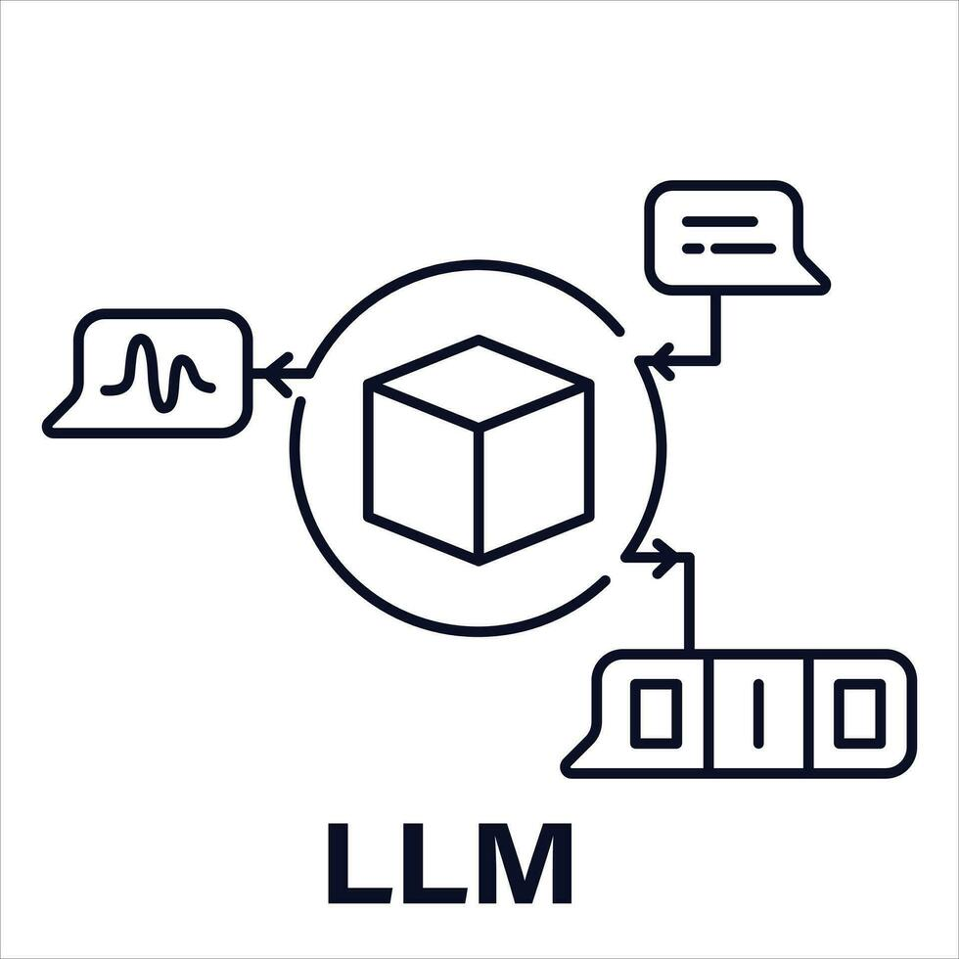


LLM For Nutrient Extraction Procedure ( Deliverable )
A language model tailored for recommending optimal methods to extract nutrients from fish.
- Process:
- Fine-tune the model on datasets related to fish nutrient extraction methods, equipment, and ingredients.
- Implement user input processing to understand specific requirements and constraints.
- Utilize the model to generate detailed recommendations based on user input.
- Ensure model comprehensively covers various extraction methods, equipment, and ingredients.
- Address potential limitations and constraints of different extraction techniques.
- Provide accurate and actionable recommendations tailored to user needs.
- Benefits:
- Improve efficiency and effectiveness of nutrient extraction processes from fish.
- Enhance decision-making by providing personalized and data-driven recommendations.
- Facilitate knowledge sharing and accessibility in the field of fish nutrition and food processing.

Slide 14
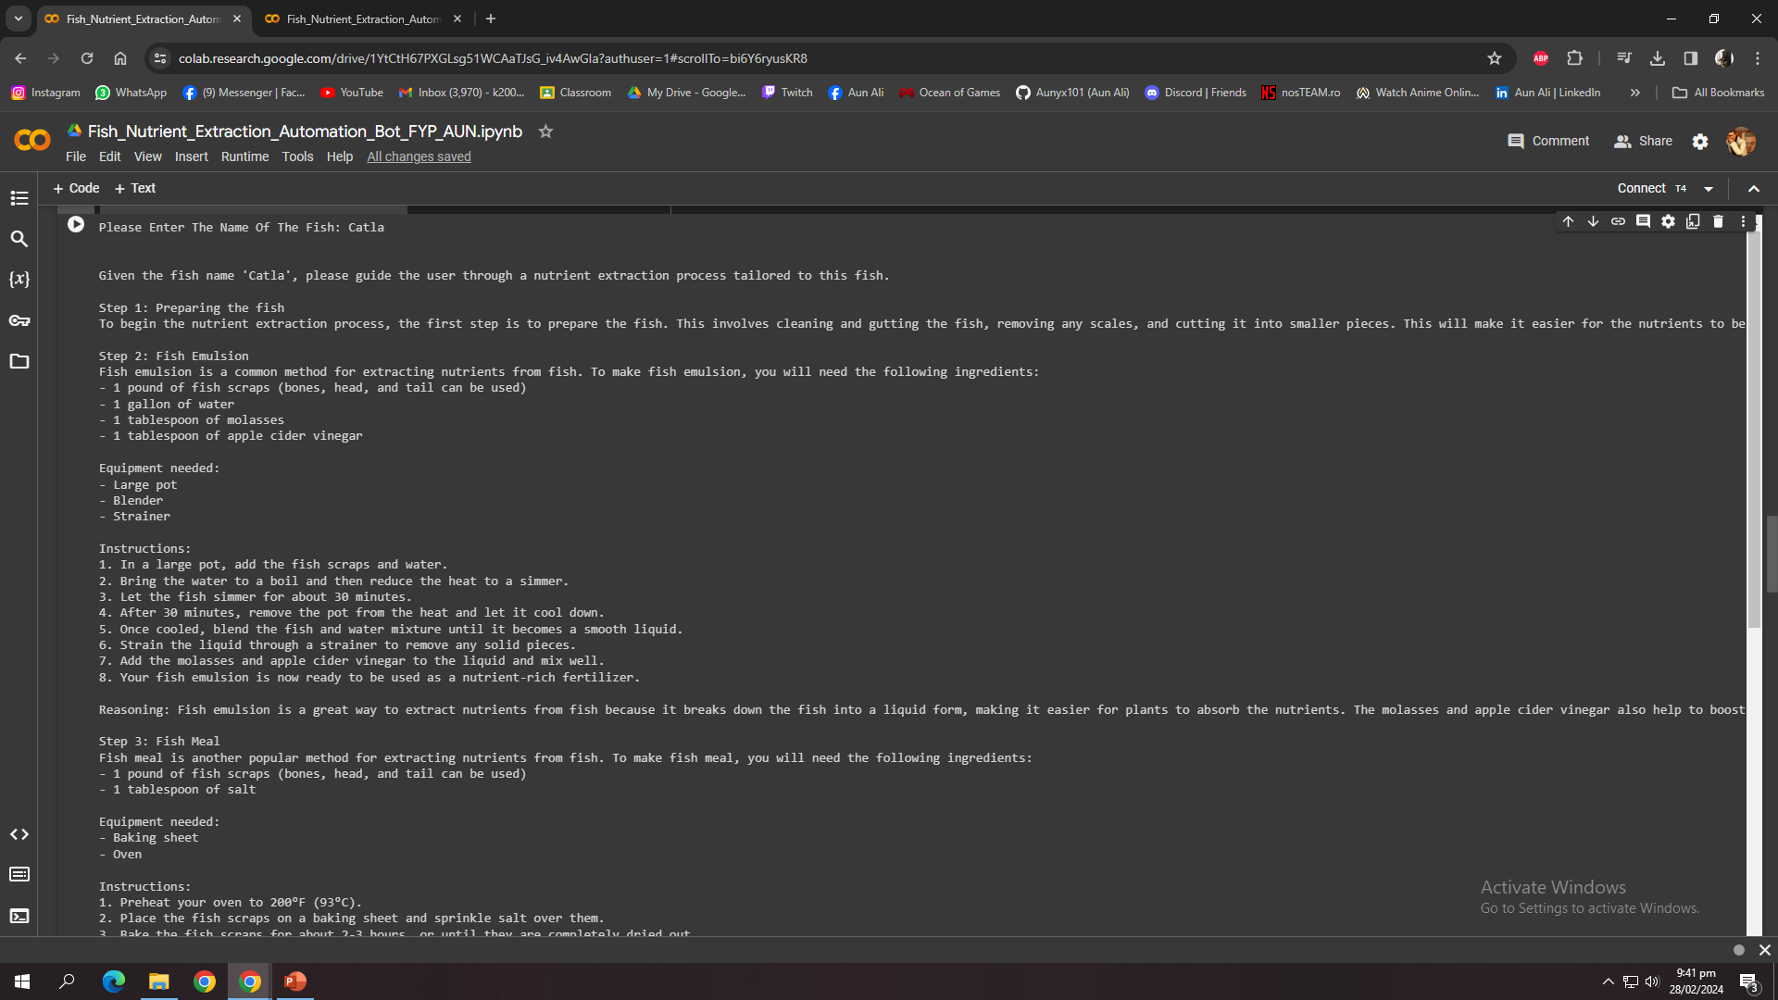

Slide 15
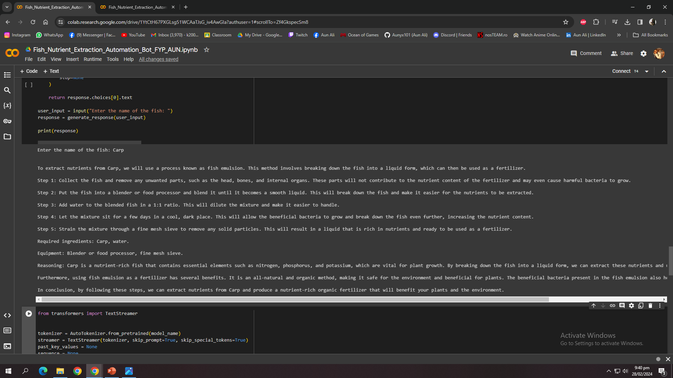

Slide 16
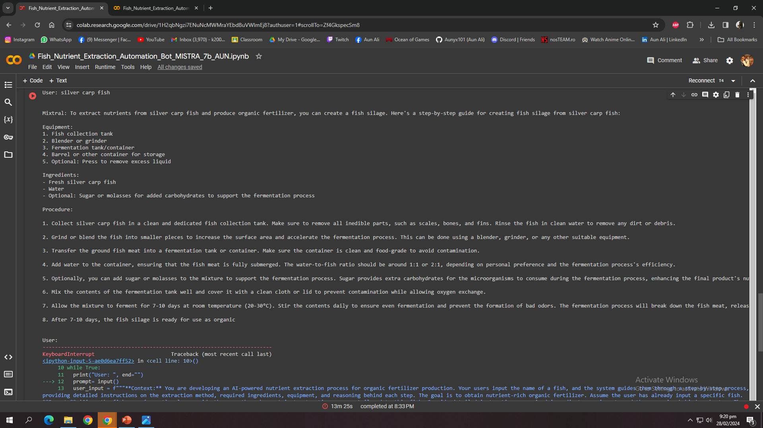

Slide 17
Work Planned For FYP II - Finals
- Objective:
- Develop a user-friendly Swift mobile application to complement the FYP project.
- Features:
- Intuitive interface, real-time data processing, and compatibility with iOS platforms.
- Development:
- Utilize Swift language, implement best practices, and integrate APIs for enhanced functionality.
- Future Plans:
- Continuous updates, user feedback integration, and potential expansion for broader impact.

Slide 18
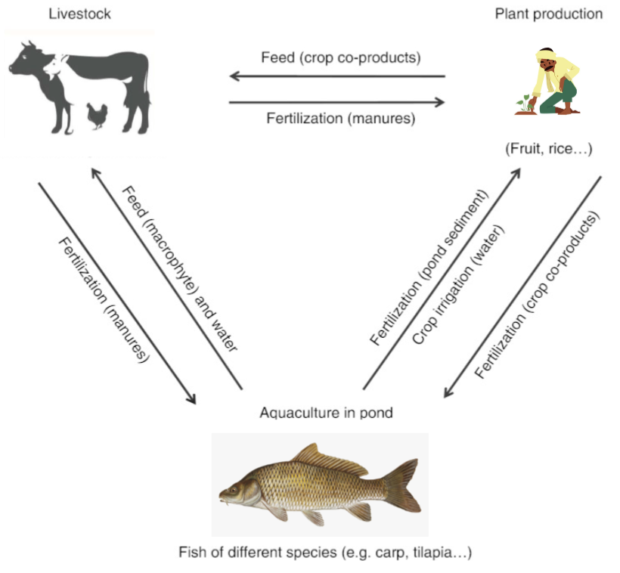
Conclusion
IAASES seeks to revolutionize agriculture in Pakistan by employing a versatile approach that integrates various techniques for soil enrichment. Our project encompasses the automation of multiple soil enrichment methods, promoting sustainability, and empowering farmers with technology-driven solutions.

Slide 19
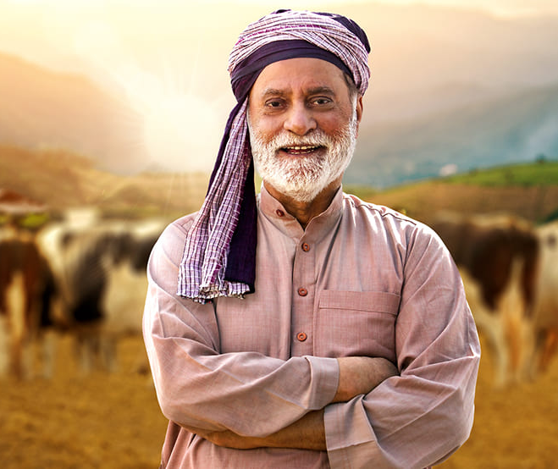
THANK YOU! ANY QUESTIONS?

